Slide 1
Classifying and Predicting
Degree Trajectories in
Longitudinal Ego Networks
Matthew J. Chandler & David Hachen
University of Notre Dame
Interdisciplinary Center for Network Science and Applications
NetHealth Project
XXXVIII Sunbelt Conference
Utrecht, The Netherlands
28 June 2018

Slide 2
Degree Trajectories:
Data
NetHealth Project Data
August 2015 - Present
720 Participants
Recruited in 3 tiers
406 pre-matriculation
94 upon matriculation
220 post-matriculation
Varying compliance rates
Surveyed 2-3 Times per Year
Personal attributes
Ego networks
Continuous Passive Observation
Mobile phone data
FitBit health/activity data
Data Used for Degree Trajectory Analyses
First 6 Survey Waves
August 2015 - December 2017
450 Participants with:
At least 3 complete ego network surveys
Complete initial personal attributes survey
Mobile phone data compliance

Slide 3
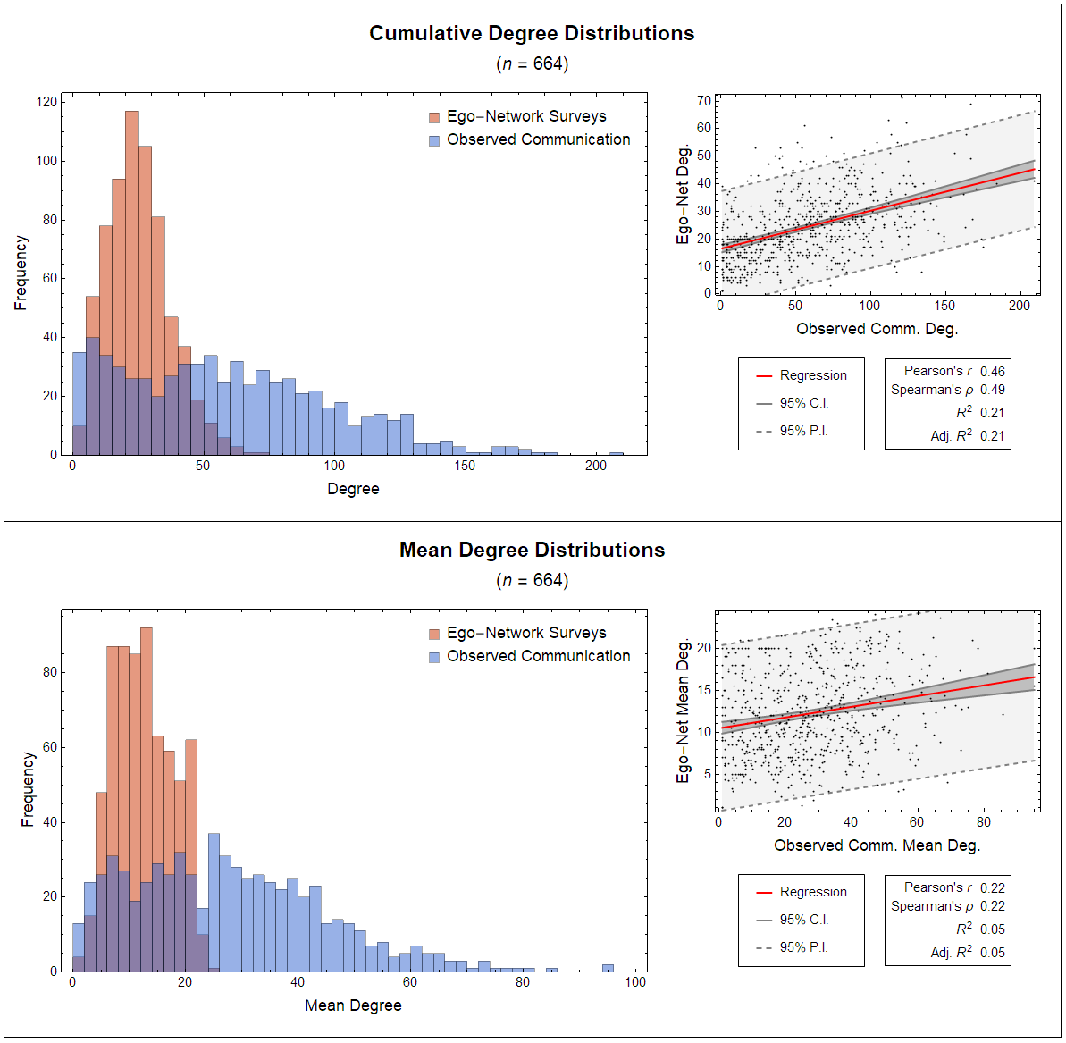

Slide 4
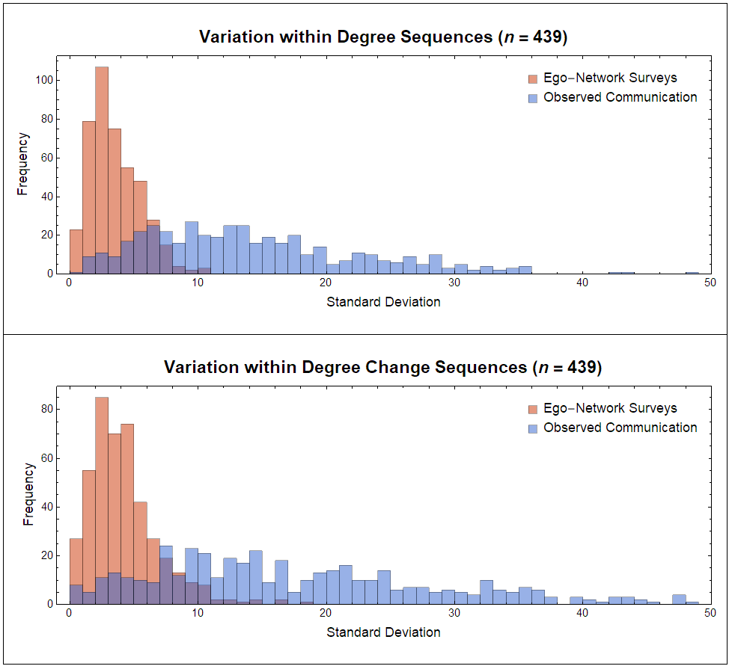

Slide 5
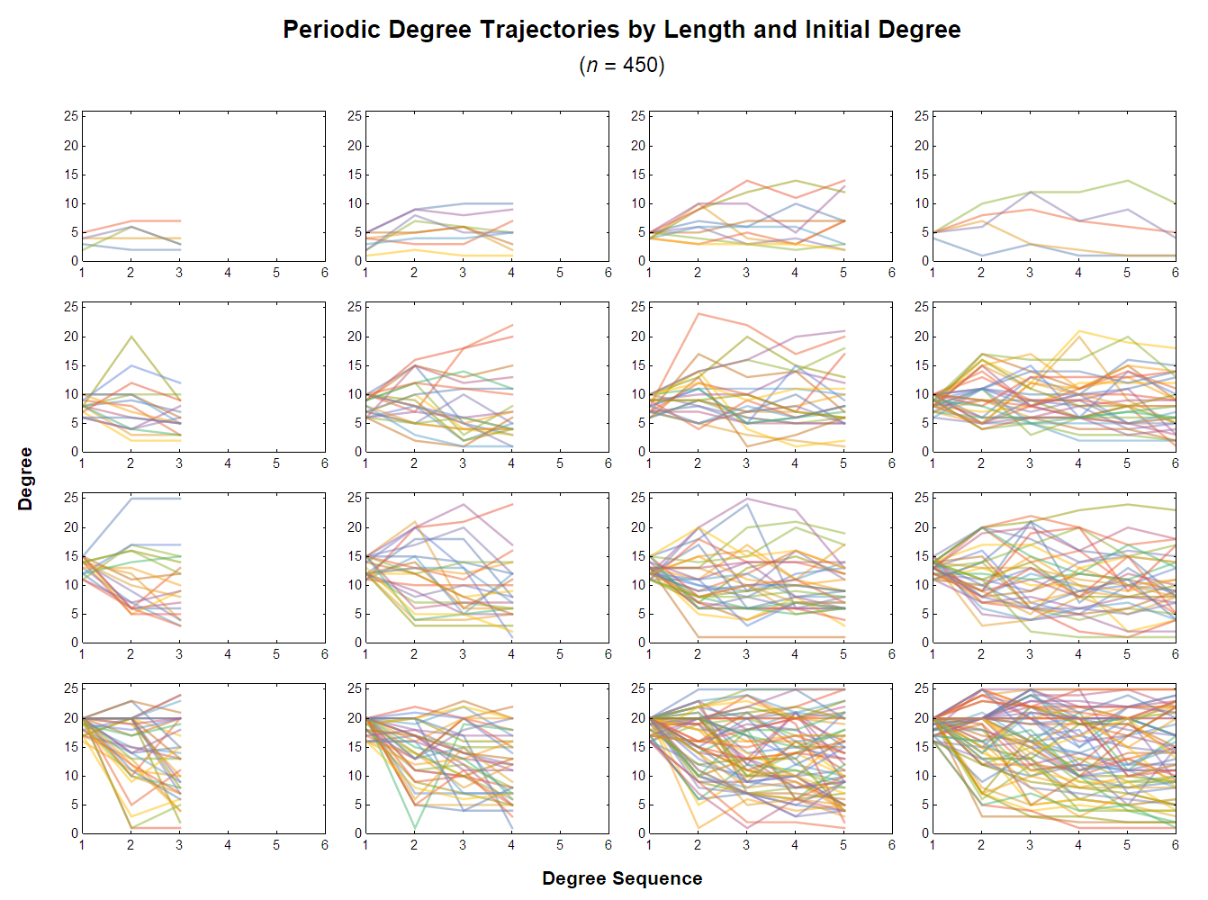

Slide 6
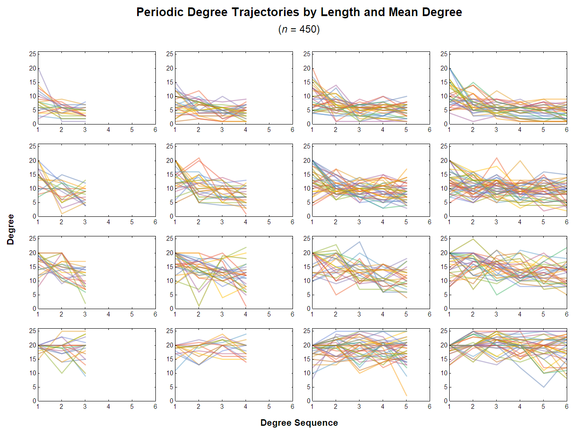

Slide 7
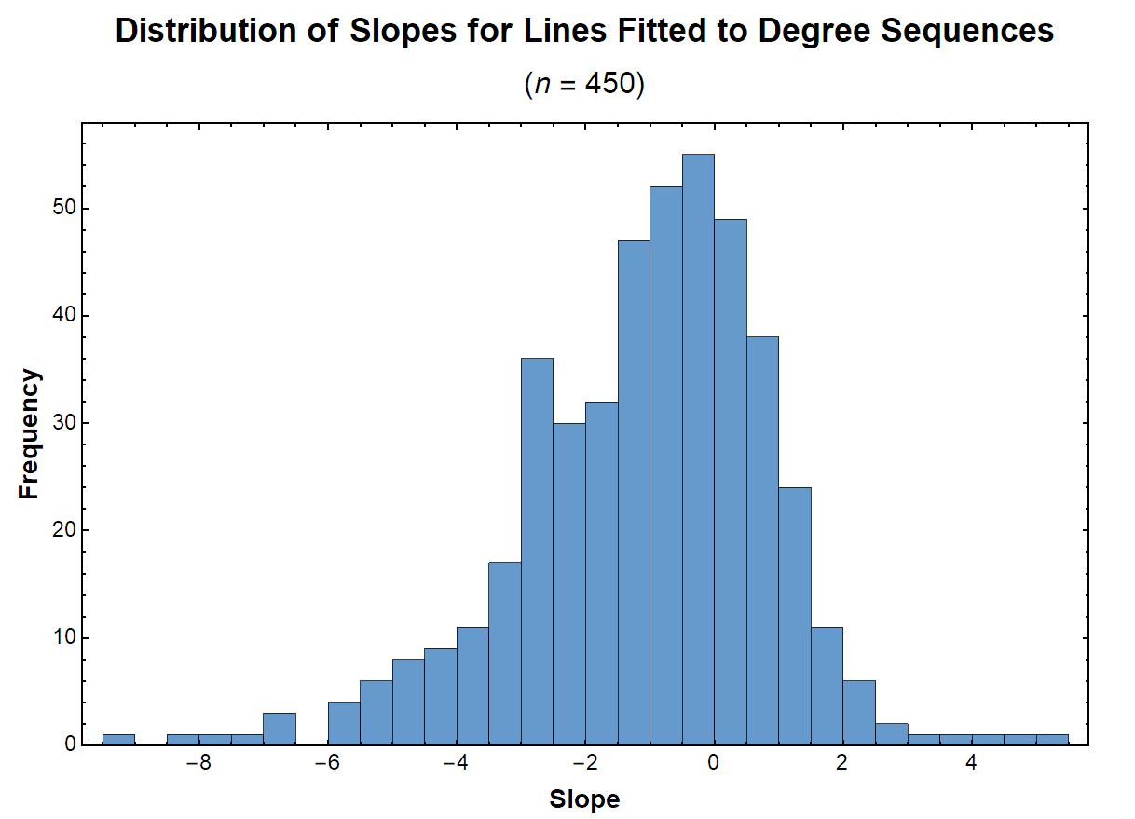

Slide 8
Degree Trajectories:
Meaningful Patterns?
At Most:
Distinct Pathways for Egos
Systematic Associations with Ego Attributes
Predictable Trajectory Types
New Insights into Social Network Evolution
At Least:
Worth Exploring

Slide 9
Classifying Degree Trajectories
Deductive Approach: A Priori Logic
Define Meaningful Pathways
Up
Down
U-Shape
Etc.
Classify with a Decision Tree
Assign in order to ensure mutual exclusivity and reproducibility
Consolidate after elaborated assignment
Inductive Approach: k-Means Clustering
Decide how many clusters (k)
Iterate the algorithm on the data 1000 times for each k, 1 - 10
Compute mean distances from the centroids at each k
Select k values with the most prominent “elbows” in the mean distance curve
Select representative clusters
Iterate the algorithm another 1000 times chosen k value
Select a particular set of clusters with mean distances closest to the central tendencies

Slide 10
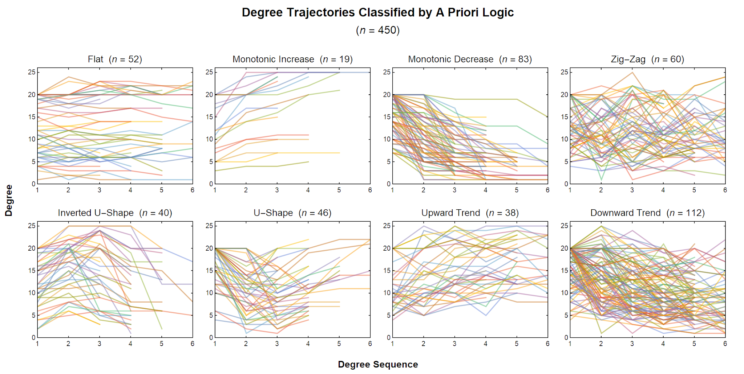

Slide 11
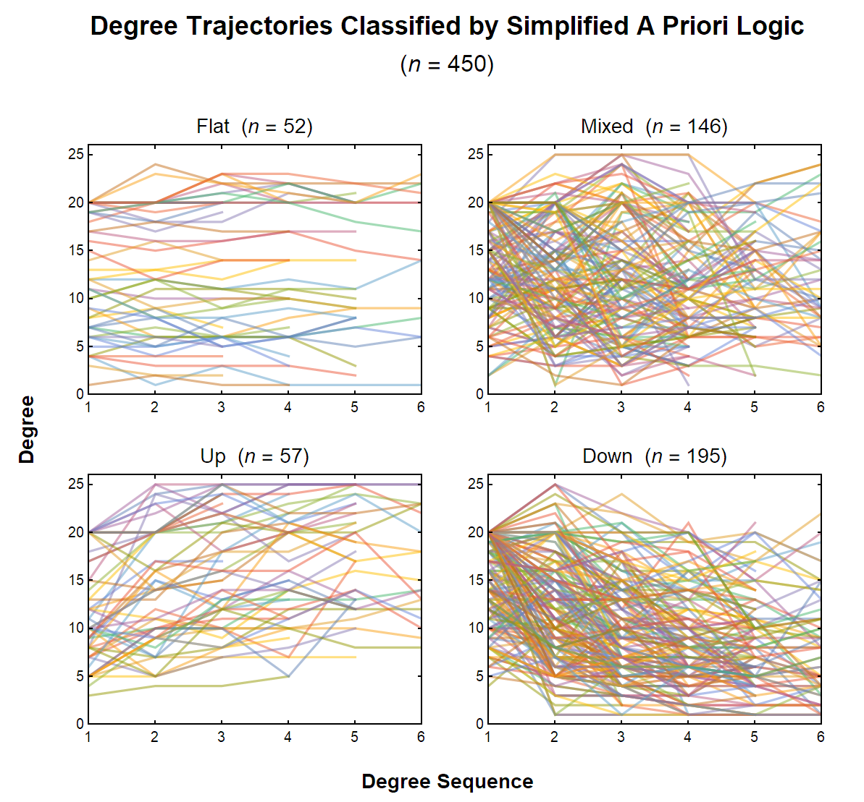

Slide 12
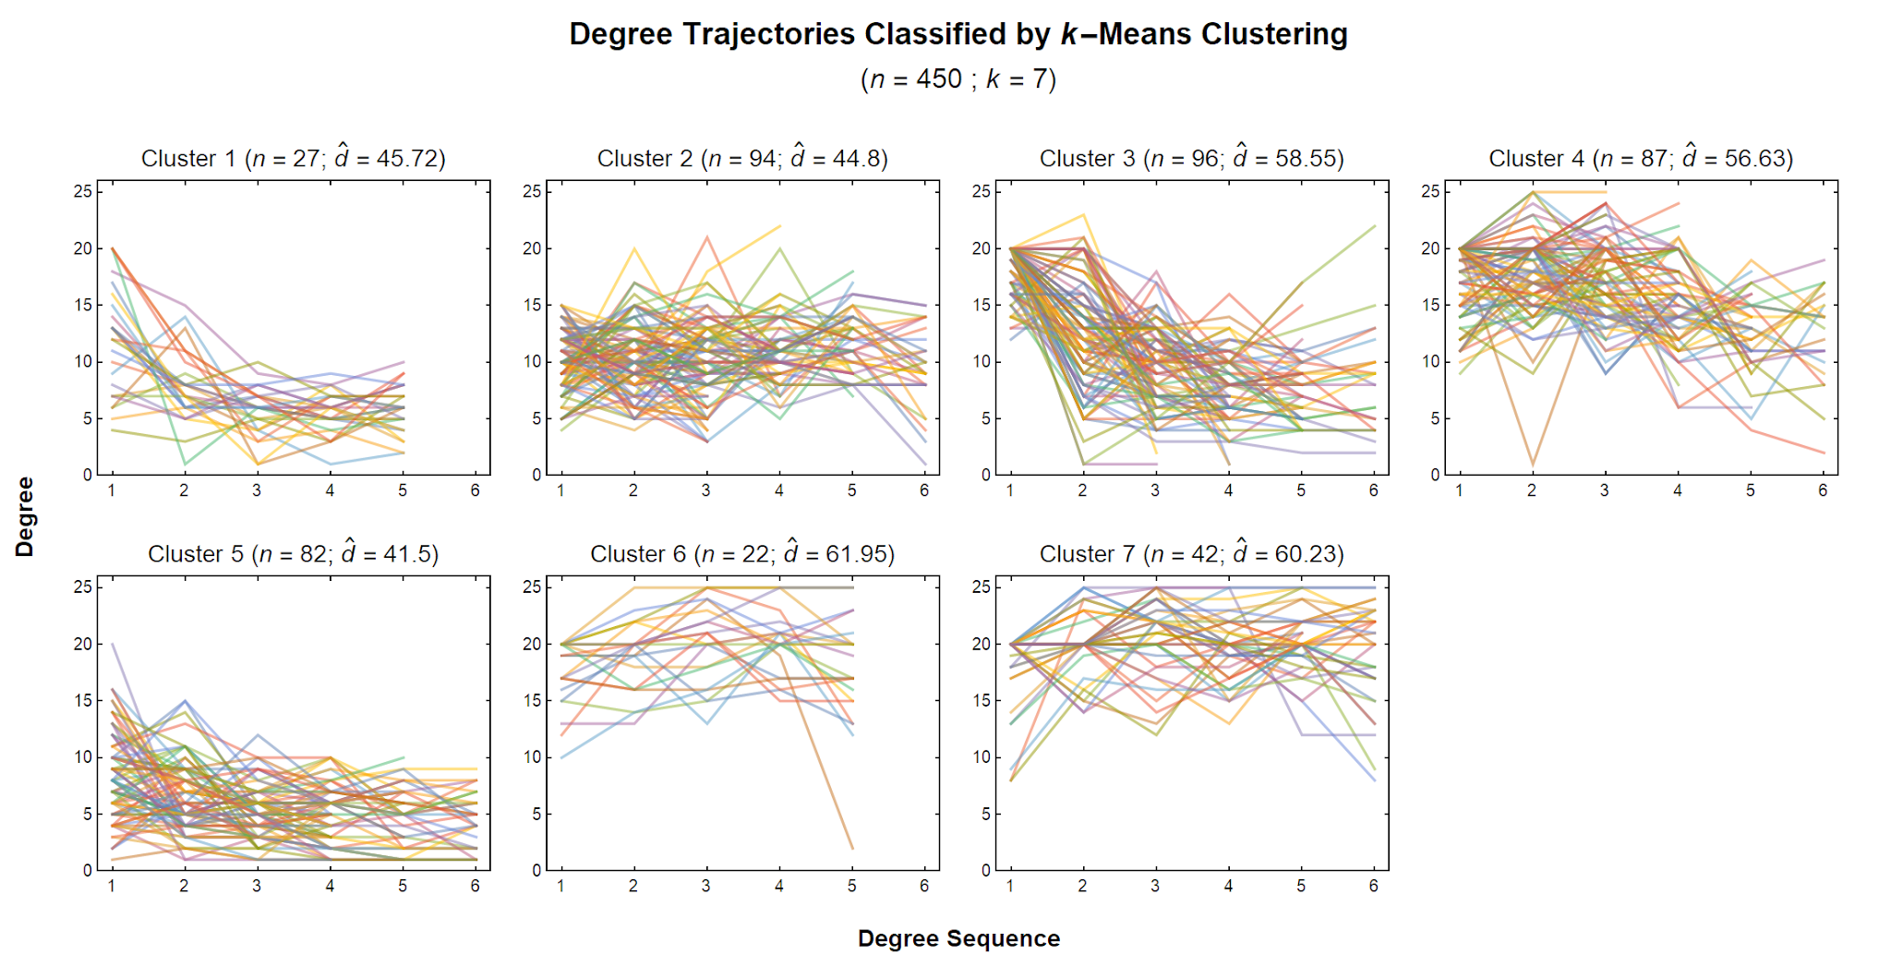

Slide 13
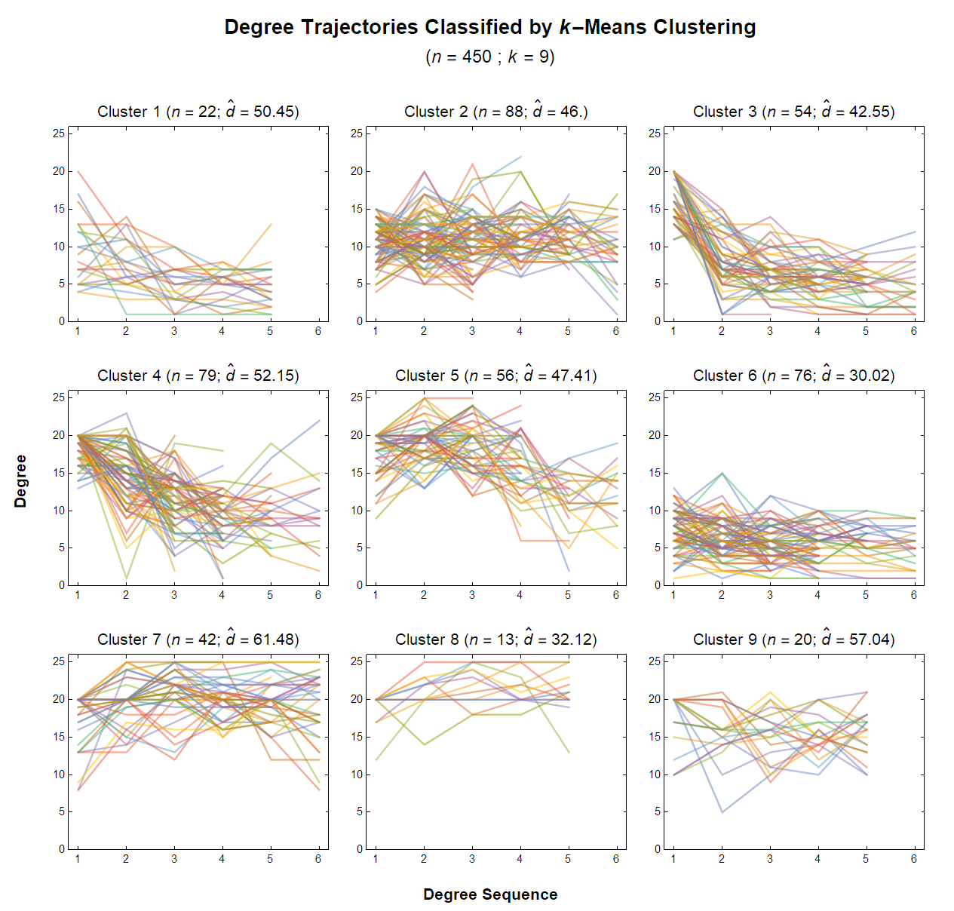

Slide 14
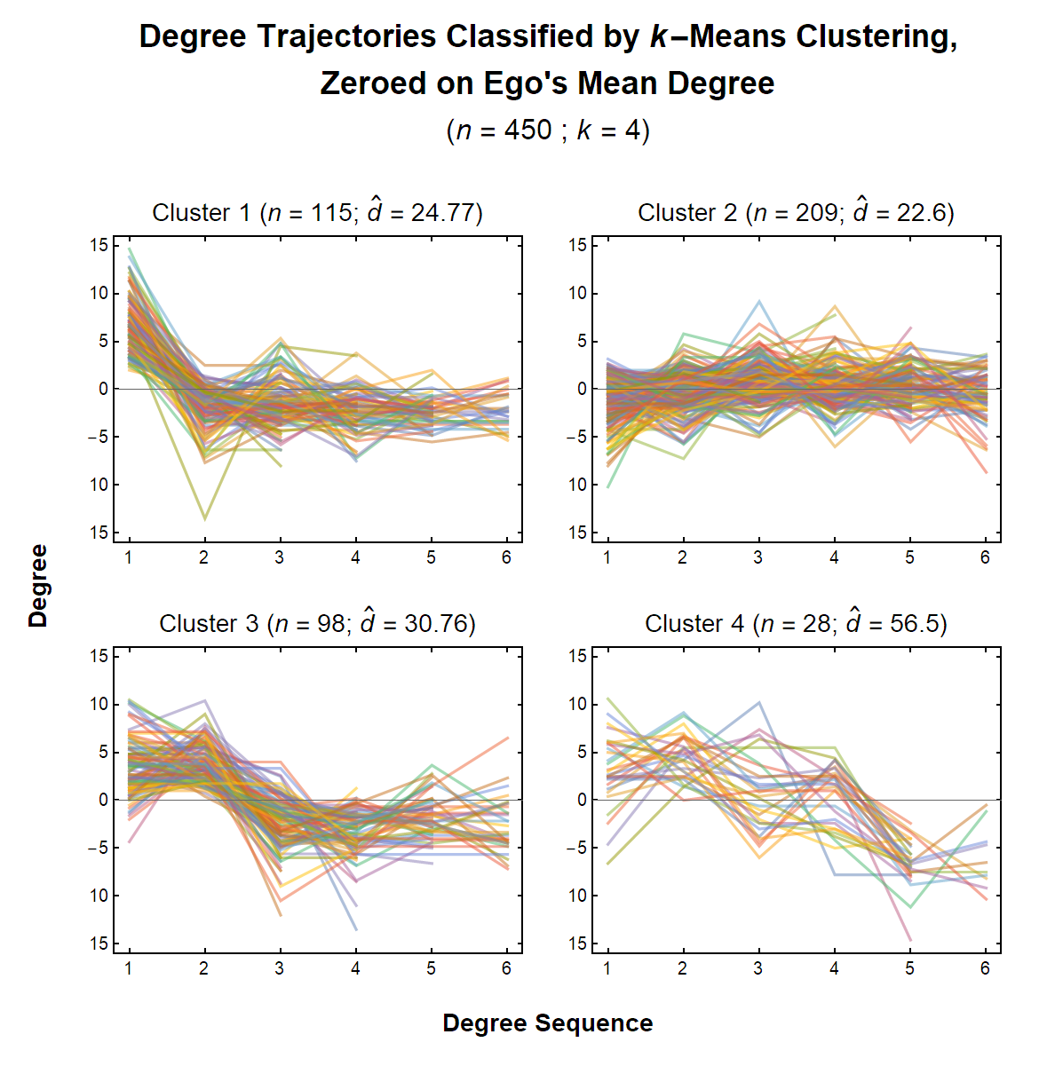

Slide 15
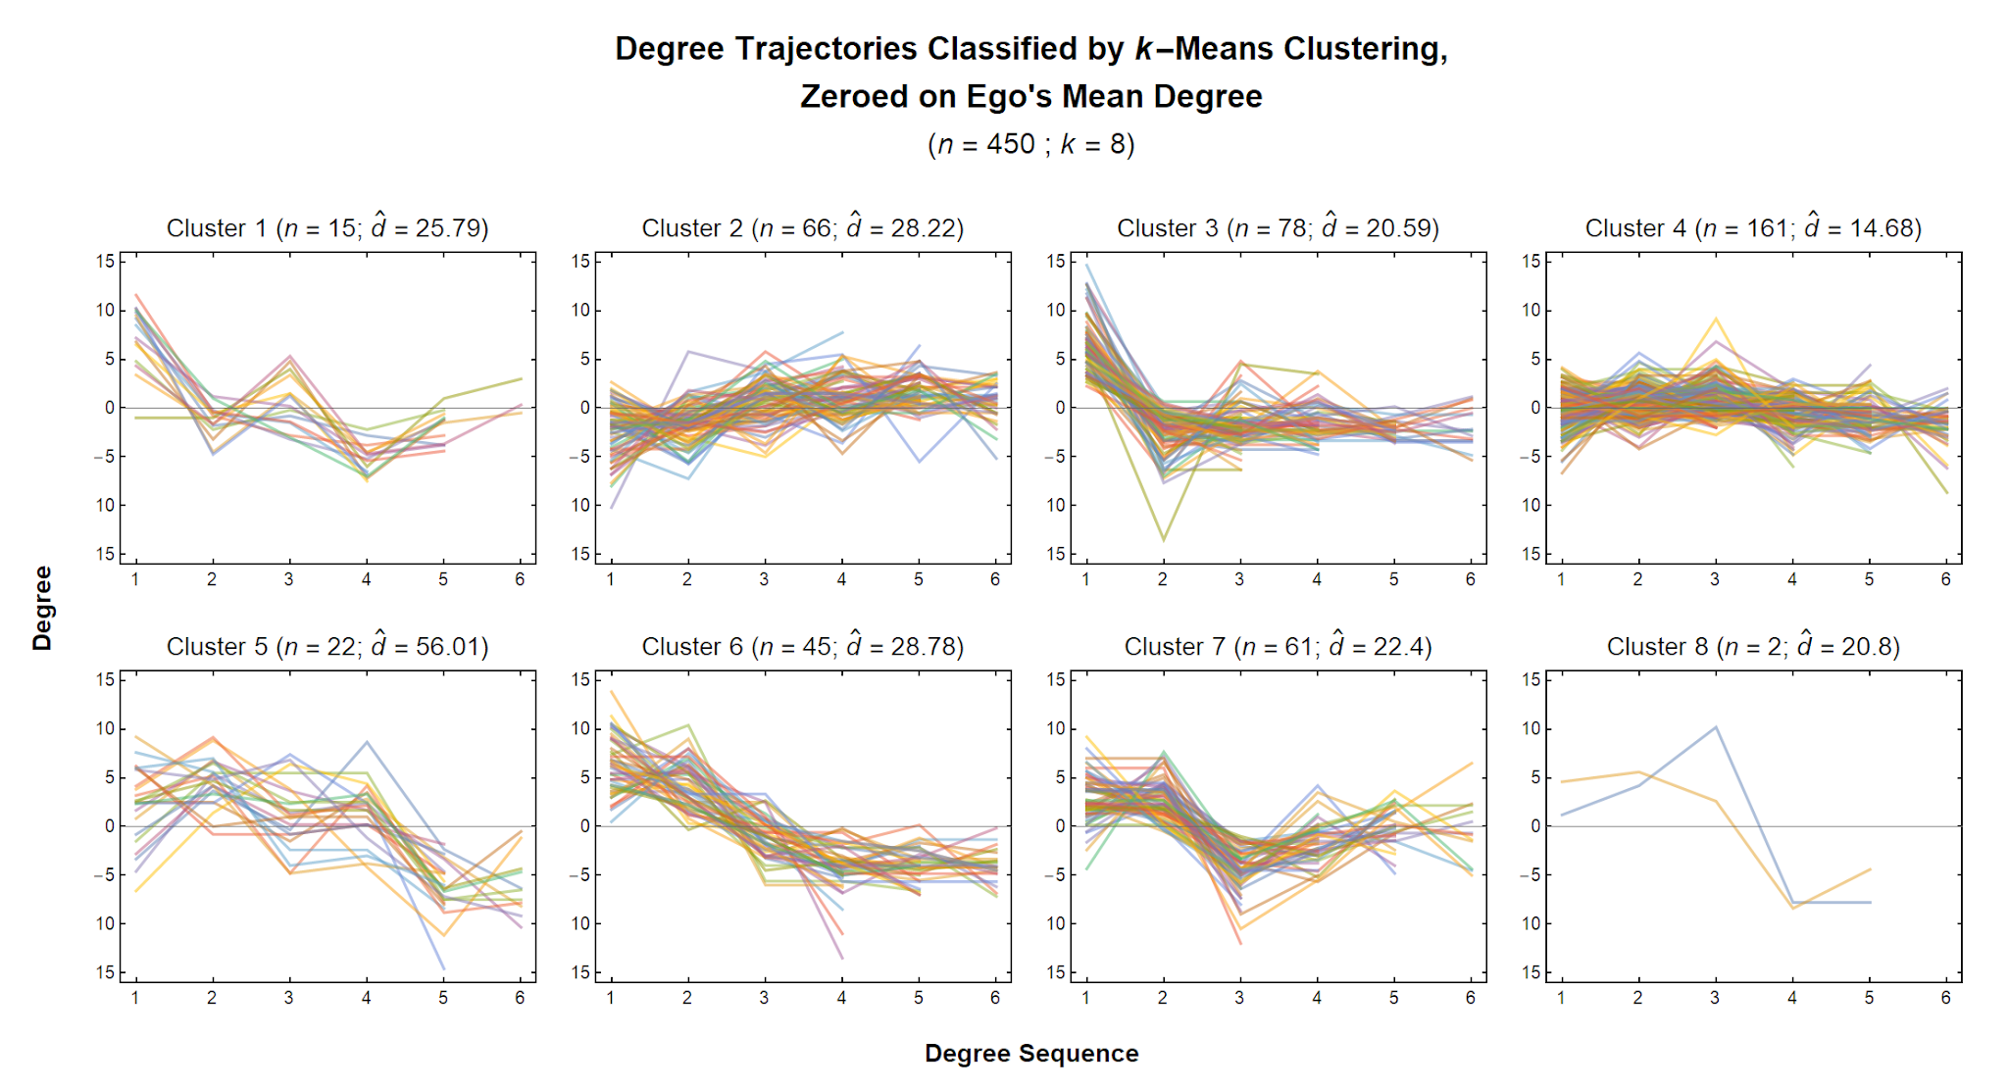

Slide 16
Predicting Degree Trajectories:
Dependent Variables
Logical Classification
8-Category Scheme
Flat
Monotonic Increase
Monotonic Decrease
Zig-Zag
Inverted-U Shape
U Shape
Upward Trend
Downward Trend
4-Category Scheme
Flat
Mixed
Up
Down
k-Means Clustering
Raw Trajectory Schemes
k = 7
k = 9
Zeroed-on-Mean Schemes
k = 4
k = 8
All dependent variables constructed from measurements concluding at or after the third survey wave.

Slide 17
Predicting Degree Trajectories:
Independent Variables
Social Demographics
Sex
Race
Socio-Economic Status
Parents’ Income
Mother’s Education
Father’s Education
Citizenship
Language
Religion
Personality Characteristics
Big Five Traits (Five Factor Model)
Agreeableness
Conscientiousness
Extraversion
Neuroticism
Openness
Trust Scale
Related Personal Attributes
Birth Order
All independent variables measured at or before the first degree measurement.

Slide 18
Predicting Degree Trajectories:
Modeling Strategy
Multinomial Logistic Regression
4 to 9 mutually exclusive categories per classification scheme
Largest class in scheme is always the reference category
Compare Multiple Fitted Models
6 different classification schemes as DVs
2 to 8 IVs per model
3 types of IV combinations
Social Demographics (5)
Personality Traits (3)
Mixed (6)
83 different models in total
(1 mixed model failed to converge)
Methods of Model Comparison
Goodness-of-Fit Statistics
Chi-squared p-value
Pseudo R-squared
Parameter Significance
Tally across models
Using p < 0.05 level
Generated from STATA’s mlogit command

Slide 19
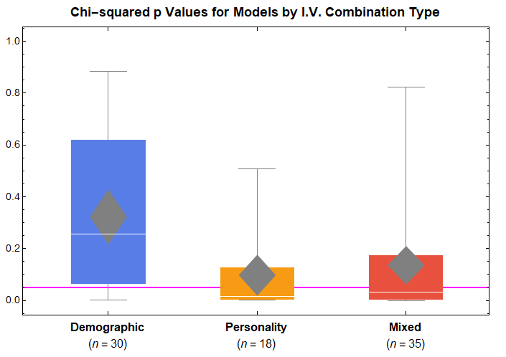

Slide 20
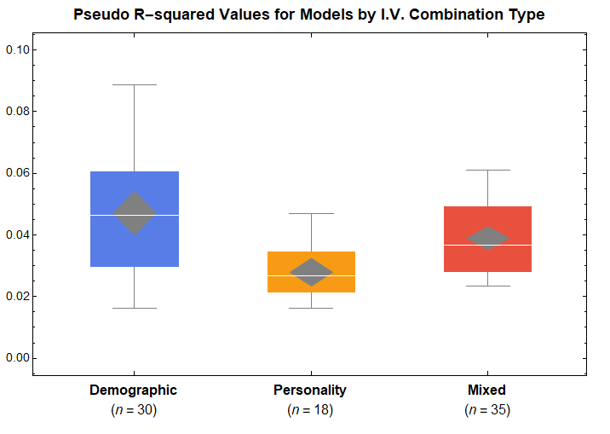

Slide 21
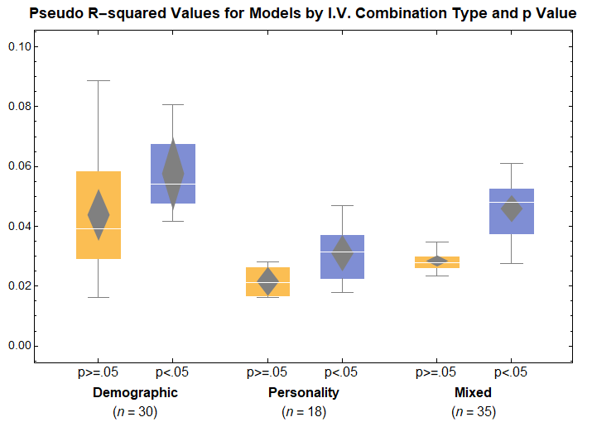
n = 23 n = 7
n = 12 n = 6
n = 21 n = 14

Slide 22
Predicting Degree Trajectories:
Results by Variable
Variable | Pr. Models p<0.05
Sex | 0.14
Race | 0.54
Parents’ Income | 0.00
Mother’s Education | 0.00
Father’s Education | 0.17
Citizenship | 0.00
Language | 0.00
Religion | 0.08
Variable | Pr. Models p<0.05
Agreeableness | 0.19
Conscientiousness | 0.17
Extraversion | 0.85
Neuroticism | 0.53
Openness | 0.43
Trust | 0.54
Birth Order | 0.00

Slide 23
Predicting Degree Trajectories:
Results Summary
Lessons
Personality models in general fit better than demographic or mixed models-- across all degree trajectory classification schemes.
The Big Five have the strongest associations with degree trajectories.
Race and Trust also appear to affect degree trajectories.
Caveats
None of the models can predict degree trajectories with substantial accuracy.
Variations between degree trajectory classification schemes not covered here.
Interactions among independent variables not yet tested.
Plenty more work to do!

Slide 24
Thank You
Matthew J. Chandler
Postdoctoral Research Fellow
chandler.20@nd.edu
David Hachen
Associate Professor of Sociology and Senior Investigator
dhachen@nd.edu
NetHealth Project
Interdisciplinary Center for Network Science and Applications
University of Notre Dame
http://nethealth.nd.edu

